Slide 1
As FAR as we know: The Extreme Events Costs of Climate Change thus FAR
Resilience Seminar – November 2019
Ilan Noy
Chair in the Economics of Disasters
Victoria University of Wellington, New Zealand
With
Dave Frame (VUW), Sue Rosier (NIWA), Luke Harrington (Oxford), Michael Wehner (Berk. Liv.)

Slide 2
Assessing the Cost of Climate Change
Integrated Assessment Models
A model of the climate
A model of the economy
A model of the integration between the two
Econometric estimates based on past observational data on the connection between the climate and economic activity

Slide 3
Assessing the Cost of Climate Change
Integrated Assessment Models
A model of the climate
A model of the economy
A model of the integration between the two
Econometric estimates based on past observational data
Both are TOP DOWN approaches

Slide 4
The Integrated Assessment Models
Howard and Sterner, 2017. Few and Not So Far Between: A Meta-analysis of Climate Damage Estimates. Environ Resource Econ, 68: 197-225.

Slide 5
let me forget about today until tomorrow

Slide 6
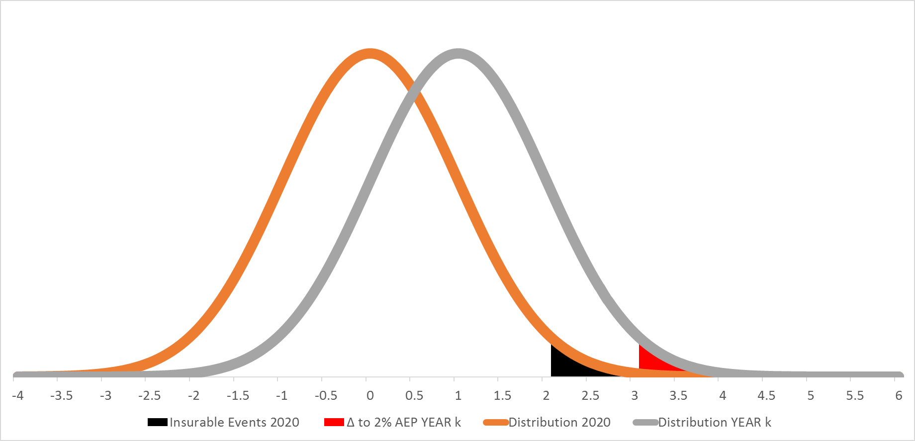
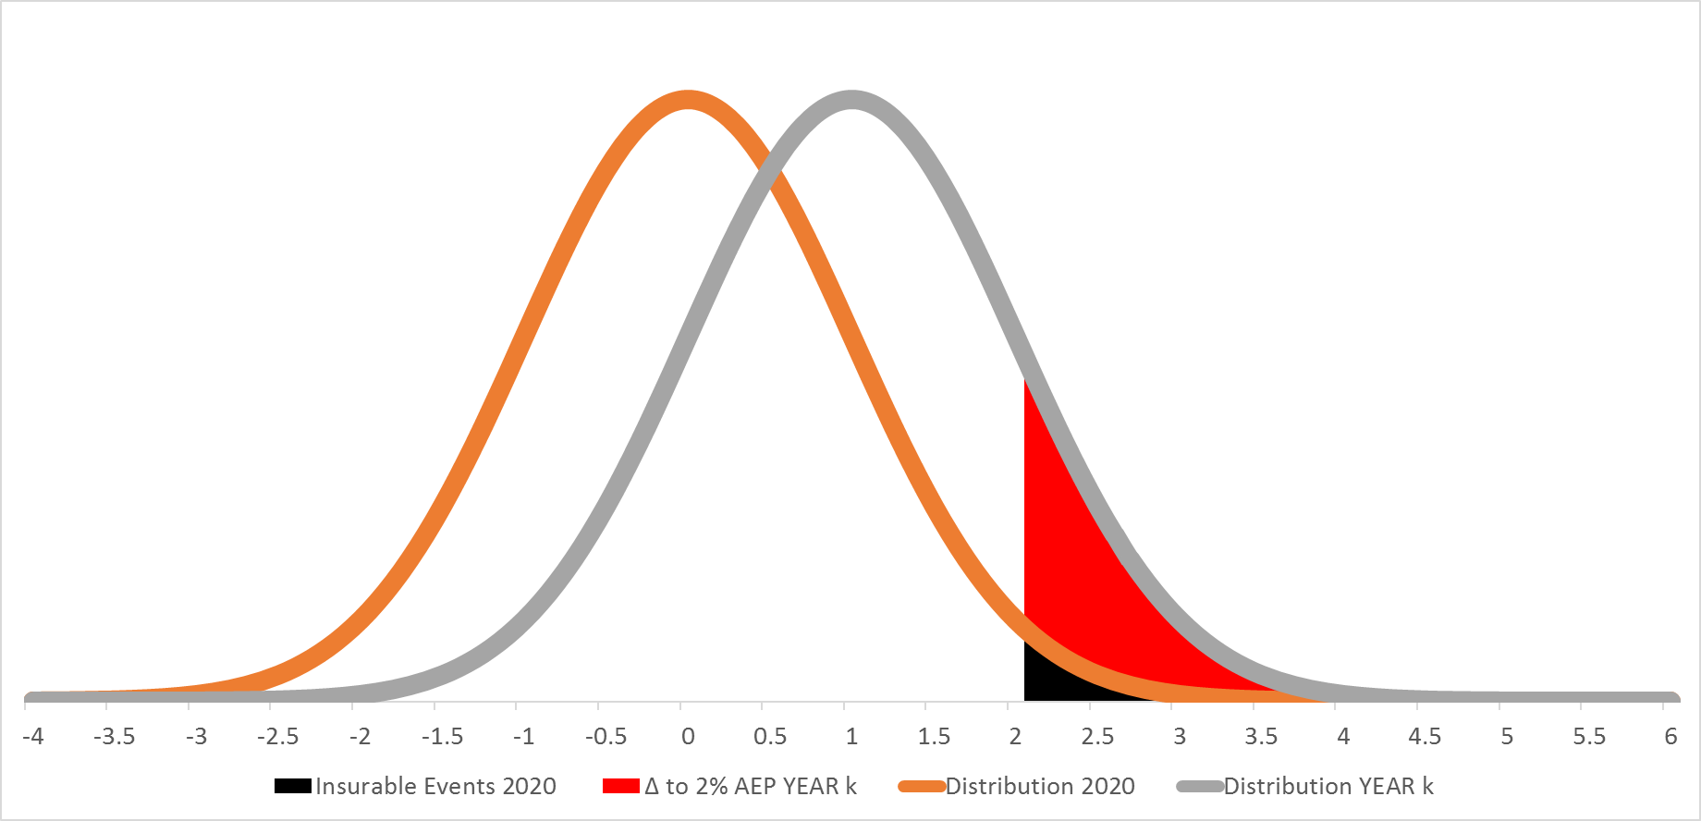
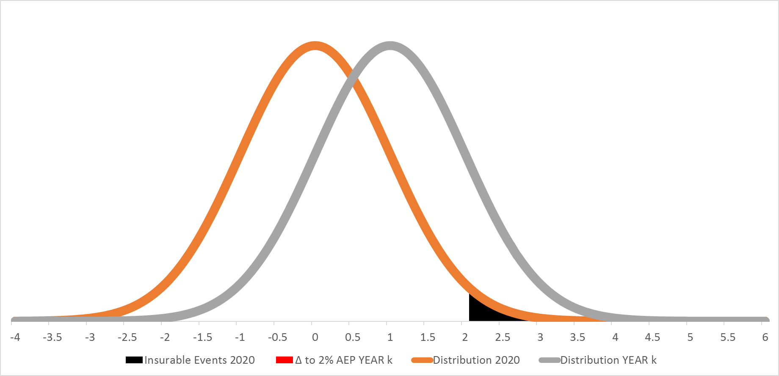
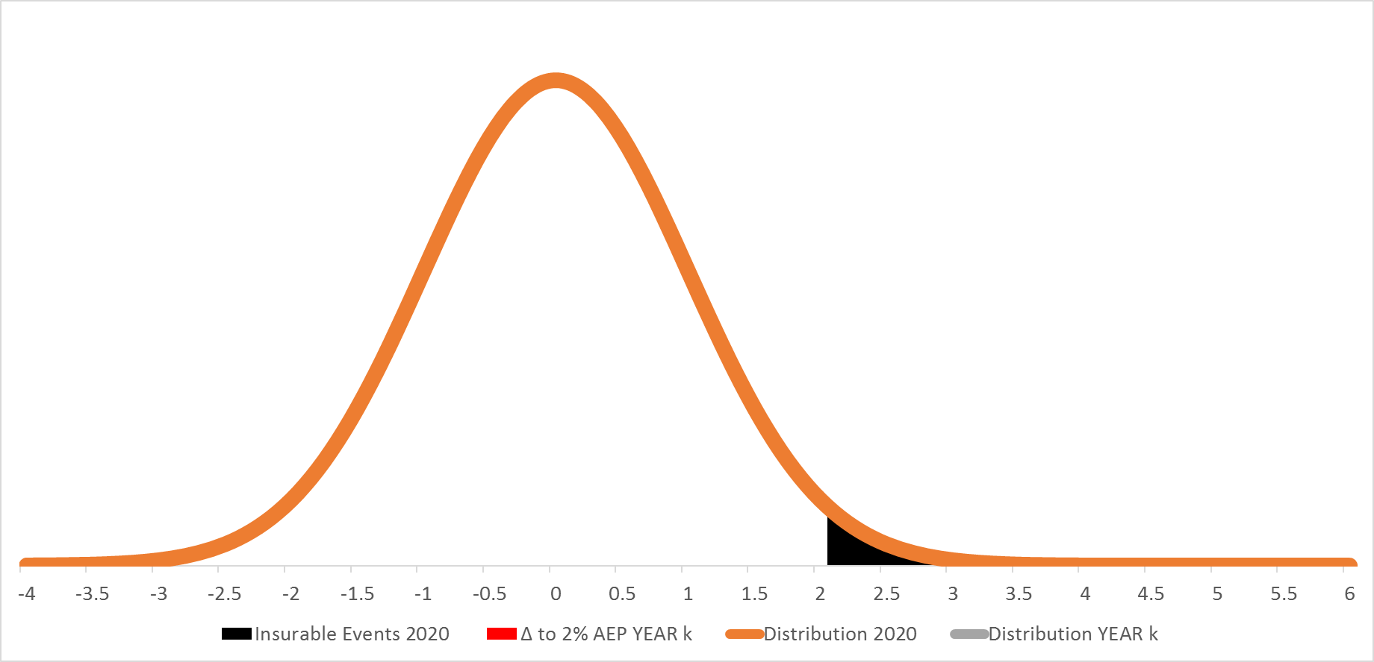
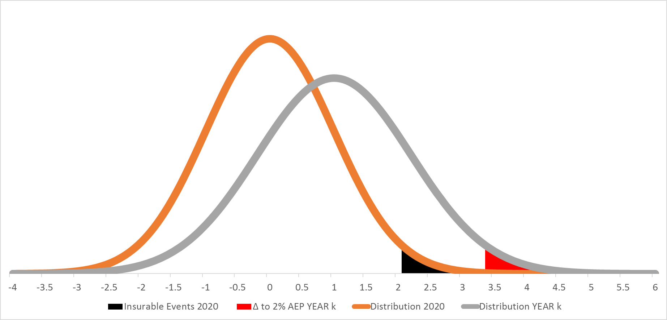
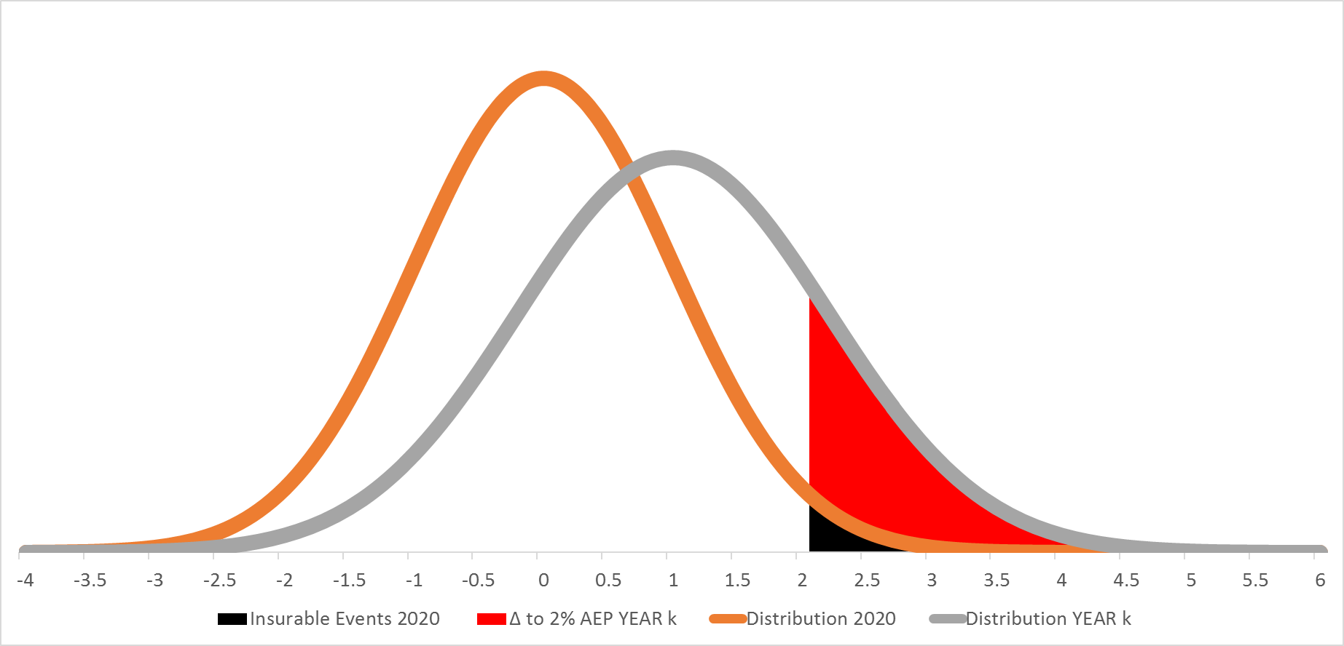
it’s a hard rain gonna fall
Source: Storey (2018)
Notes:
Normal standard distribution
Move by 1.0σ to the right by year k
This is equivalent to an event that occurred 1 in 6 (i.e. at 1 standard deviation) becoming the new mean (i.e. 0 standard deviations). However it also means that something that was previously a 1 in 740 years (i.e. at 3 standard deviations) becoming the new 1 in 44 years (i.e 2 standard deviations).
Assumes insurance retreat threshold of ~2% AEP (i.e. 1 in 50 year event)
Assumes a change in the standard deviation (i.e. the shape of the curve by 0.2σ (i.e. move to the right of 1.0σ and change in shape of 0.2σ)

Slide 8
Strange things have happened, like never before
Fraction of attributable risk (FAR) = “The fraction of the likelihood of an event that is attributable to a specific causal factor.”
Suppose probability of a given event is 1 in 50 in ‘natural’ (P_{n} = 1/50) and 1 in 10 in ‘climate change’ scenario (P_{cc} = 1/10)
FAR = 1 – [(1/50)/(1/10)] = 0.8
80% of the risk of that event is attributable to anthropogenic climate change

Slide 9
Long ago, FAR away?
Definition of Climate Change Attribution: “Quantifying the role of GHG in changing the probability of specific extreme weather event.”
Two approaches:
Observational
Modelled
Because we are interested in rare events, we need a very long time-series (for #1)
or a large numbers of model runs to capture the statistics of the tail (for #2).

Slide 10
weather@home with distributed computing

Slide 11
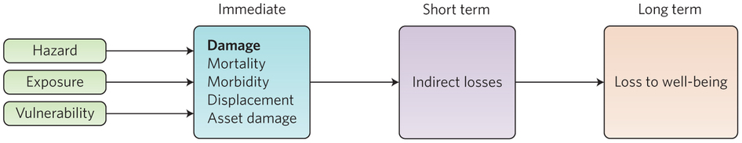
Well, I sailed through the storm, strapped to the mast The Economic Costs of Storms
Noy, 2016. Tropical Storms: The Socio-Economics of Cyclones. Nature Climate Change 6: 343-345.

Slide 12
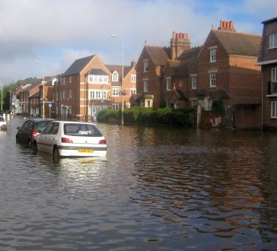
Multiplying the Two: FAR X Cost
“If A has trebled the risk over its ‘pre-industrial’ level, then there is a sense in which A is ‘to blame’ for two-thirds of the current risk….
We are not yet in the position to produce such figures for the contribution of greenhouse-gas emissions to the increased risk of flooding in south Oxford…But the point is, if we get the science right, we could be….”
Allen, 2003. Liability for climate change. Nature 421, 891-892.

Slide 13
Case I: If you go down in the flood
Year | Date | Location | FAR | Insured Cost ($M) | Attributable Cost ($M)
2017 | April | North Island | 0.35±0.2 | 91.46 | 32.011
2007 | July | Upper North Island | 0.30±0.2 | 72.7 | 21.81
2017 | March | Upper North Island | 0.40±0.2 | 61.7 | 24.68
2013 | April | Nelson, BoP | 0.30±0.2 | 48.2 | 14.46
2015 | June | Lower North Island | 0.10±0.2 | 42.4 | 4.24
2016 | March | West Coast-Nelson | 0.40±0.2 | 30.9 | 12.36
2015 | June | Otago | 0.05±0.2 | 28.8 | 1.44
2015 | May | Lower North Island | 0.30±0.2 | 22.4 | 6.72
2011 | January | Northland to BoP | 0.30±0.2 | 21.3 | 6.39
2014 | July | Northland | 0.30±0.2 | 19.3 | 5.79
2017 | April | Mostly North Island | 0.35±0.2 | 17.2 | 6.02
2007 | March | Far North | 0.30±0.2 | 15.2 | 4.56
Total attributable extreme rainfall insurance costs |  |  |  |  | $140.48

Slide 14
Case II: Trouble in the city, trouble in the farm Droughts
Year | Date | FAR | Indirect Losses ($M) | Attributable Losses ($M)
2007/08 | Summer | 0.15 (0.05-0.4) | 3,237 | 485
2012/13 | Summer | 0.20 (0.15-0.4) | 1,575 | 315
Total attributable extreme rainfall insurance costs |  |  |  | $800

Slide 15
The Next Steps:
Establish a comprehensive Extreme Weather Events loss database
Formalize the calculation of FARs for each past event
Storms / cyclones – feasible with current modelling (esp. percip.)
Fires – need to add forest models
Hail – not yet; maybe possible with downscaling
Frost – modelling not there yet
Tornadoes – not even close
Project the future

Slide 16
Case III: I'll give ya shelter from the storm

Slide 17
“This is a tough hurricane…tremendously big, and tremendously wet…one of the wettest we've ever seen from the standpoint of water.” (D. Trump, 2018)

Slide 18
Anthropogenic Hurricane Harvey = 67 US$B
ATTRIBUTION | FAR
van Oldenborgh et al. (2017) | 0.67 (0.33 – 0.8)
Risser & Wehner (2017) (large region) | 0.8
Risser & Wehner (2017) (small region) | 0.9
COSTS | Direct damage (In 2017 US$B) | Insured damage (In 2017 US$B) | Number of people affected (in thousands) | Mortality
NOAA | 125 |  |  | 68
EMDAT | 95 | 30 | 582 | 88
MunichRe | 85 | 30 |  | 88
SwissRe | 85 | 30 |  | 88

Slide 19
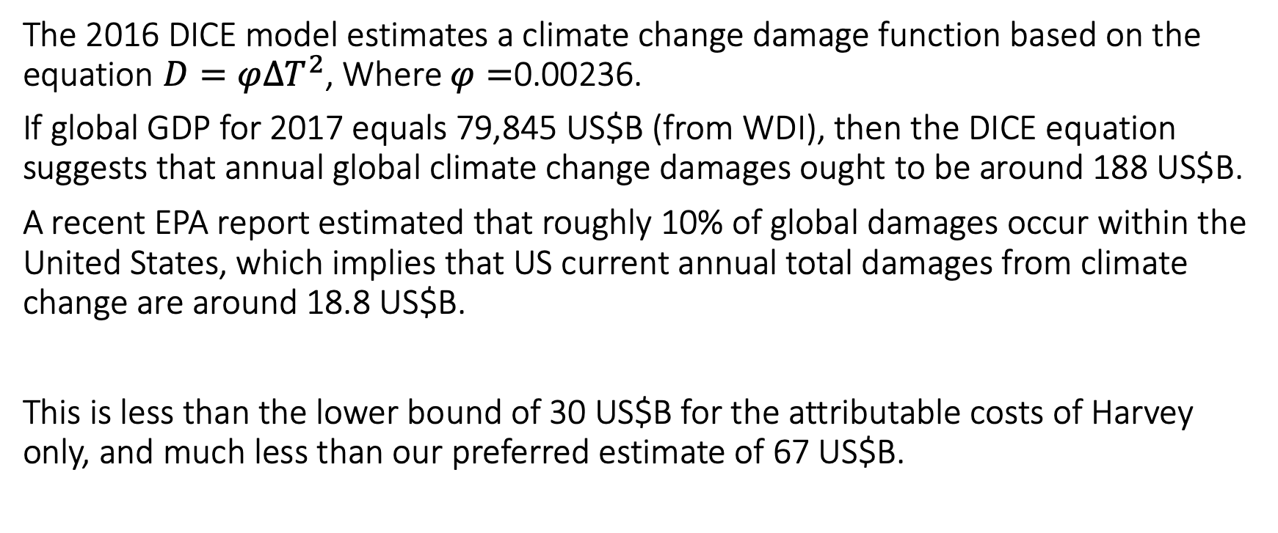
FAR and DICE
The 2016 DICE model estimates a climate change damage function based on the equation $D=φ{∆T}^{2}$, Where $φ=$0.00236.
If global GDP for 2017 equals 79,845 US$B (from WDI), then the DICE equation suggests that annual global climate change damages ought to be around 188 US$B.
A recent EPA report estimated that roughly 10% of global damages occur within the United States, which implies that US current annual total damages from climate change are around 18.8 US$B.
This is less than the lower bound of 30 US$B for the attributable costs of Harvey only, and much less than our preferred estimate of 67 US$B.

Slide 20
Case III: The World - PRELIMINARY

Slide 21
Case III: The World - PRELIMINARY

Slide 22
Summarizing our global database
The answer is blowing in the wind…

Slide 23
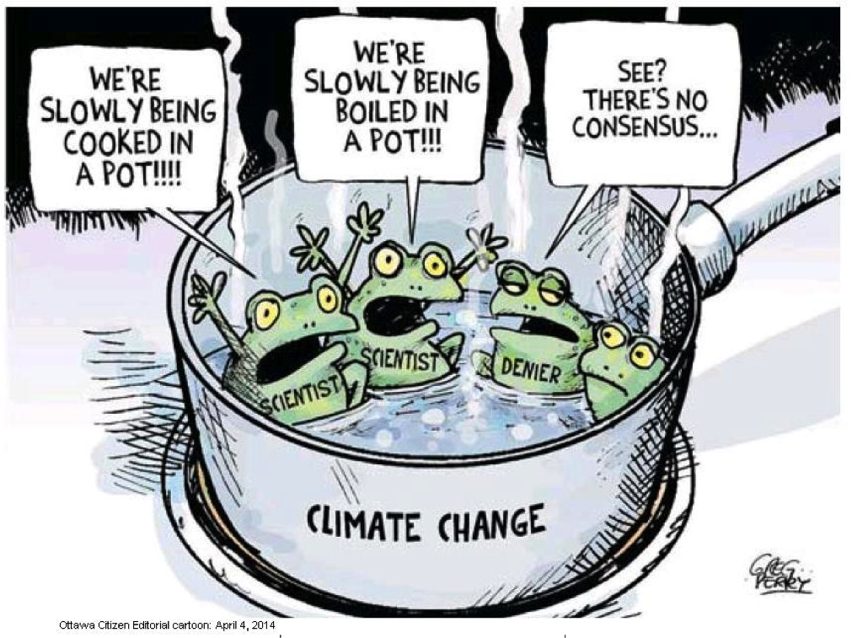
And how many times can a man turn his head And pretend that he just doesn't see?

